Slide 1
Natural Selection

Slide 2
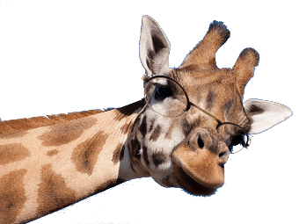
By the end of this lesson, you should be able to:
• | Explain how natural selection drives evolutionary change.
• | Understand the requirements needed for natural selection to occur.

Slide 3
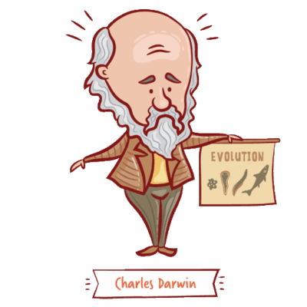
Natural selection was first proposed by Charles Darwin.
Darwin's idea was that populations typically produce more offspring than the surrounding environment can support. As a result, there is competition for survival.

Slide 4
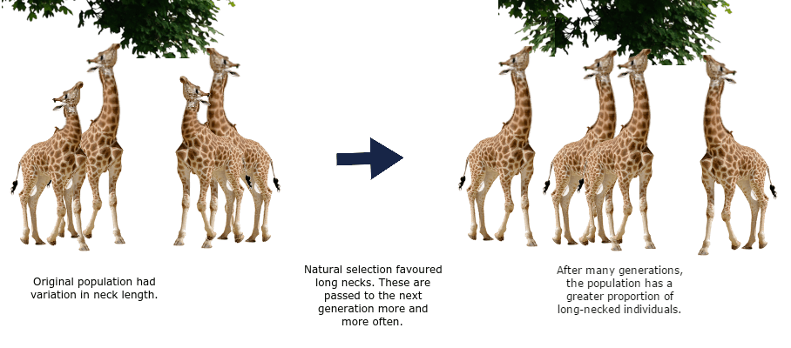
Natural selection is the increase or decrease in the frequency of certain alleles within a population.
The change in alleles may be caused by biotic (living) or abiotic (non-living) pressures.

Slide 5
Organisms with beneficial phenotypes will be better equipped to survive, reproduce, and, therefore, pass their advantageous genes on.
Over time, advantageous genes become more common in the gene pool.

Slide 6
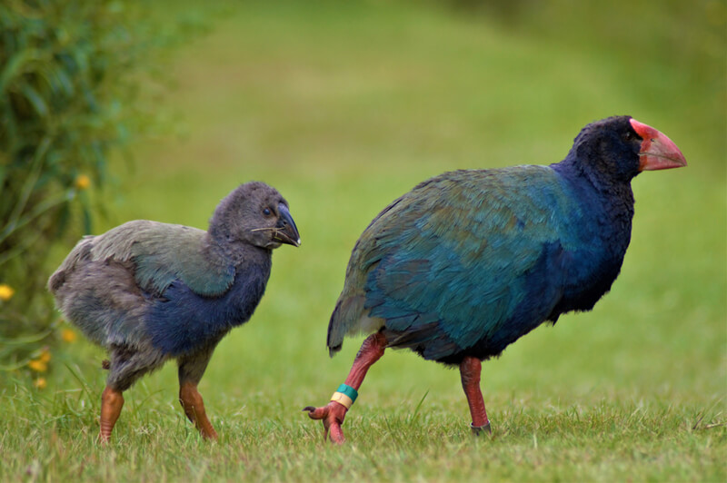
Natural selection can appear random, due to having no specific end goal aside from making organisms best suited to their environment.
It is a process in which an organism adapts (becomes better-suited to their environment), through nature selecting for genes that code for advantageous phenotypes.

Slide 7
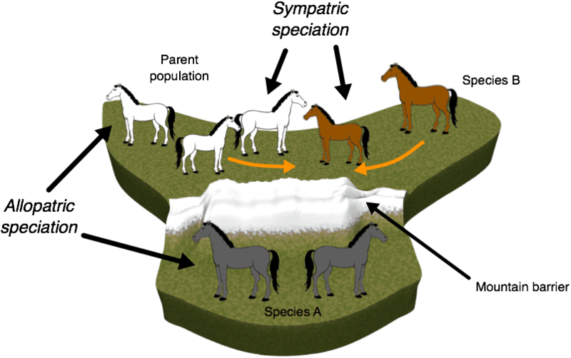
Several processes are involved in natural selection:
• variation,
• isolation and competition
and
• selection.
Natural selection requires these processes, and given enough time, can result in speciation or the formation of a new species.

Slide 8
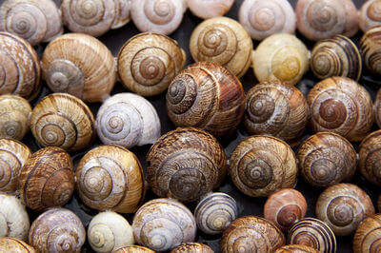
Populations must have existing variation for natural selection to occur.
Variation is when a population has a range of different phenotypes, due to large genetic diversity, or range of genes available.
This is so phenotypes that aid survival are available to be selected for, if the environment changes.

Slide 9

Mutations, gene flow, and genetic drift all act to change the allele frequency within a population, and also the variation of phenotypes.
Genetic diversity (and variation of phenotypes) is necessary to avoid extinction when selection pressures change.
If the advantageous gene already exists in the gene pool, organisms with this gene can survive and reproduce, and make the advantageous allele more common.

Slide 10
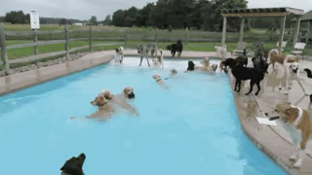
To be called a species, members must be able to reproduce with one another and produce offspring that are also able to reproduce (i.e. offpsring that are viable).
As long as members of populations of a species are able to interact and reproduce, they can pass genes between their gene pools. Therefore they will remain the same species.

Slide 11
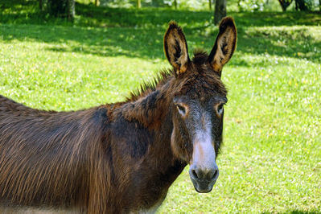
For example, although different breeds of dogs look very different, they are still able to reproduce viable offspring, so are the same species.
Donkeys and horses however, can produce offspring, but these offspring (mules) cannot reproduce themselves (are not viable). Therefore, horses and donkeys are classed as two different species.

Slide 12
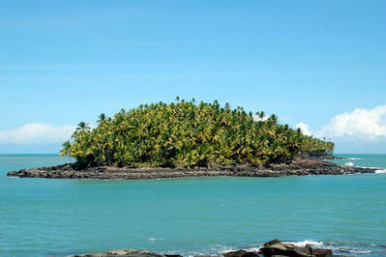
The population on which natural selection is acting must be isolated from other populations of the species, often geographically.
If the two populations are not isolated, then genes will pass between the two populations via interbreeding and gene flow, and the two populations will not become two different species.

Slide 13
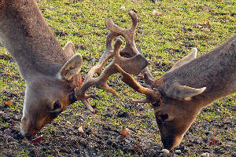
Competition between organisms can occur for food, mates and habitats.
Weaker organisms are likely to be outcompeted, and will often die before being able to pass on their genes.
This is necessary because it means only organisms with phenotypes advantageous to survival, will live to reproduce and pass on their genes.

Slide 14
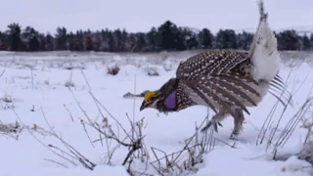
The final requirement for natural selection is selection.
Selection pressure is a force that favours organisms with advantageous genes (and therefore phenotypes) over those without them.
This causes the allele frequency of a population to change, with the advantageous variation of a gene becoming more frequent.

Slide 15
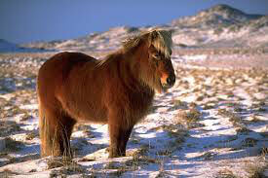
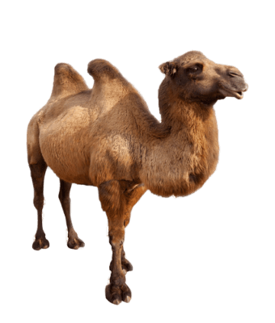
For example: a cold climate is a selection pressure from nature for thick fur.
A hot and dry climate is a selection pressure for needing to drink very little water, as with camels.

Slide 16
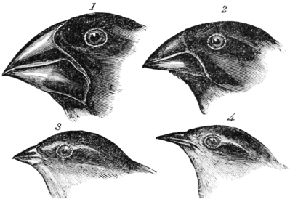
Speciation is the process by which one species splits into two or more separate species.
If enough natural selection of desirable phenotypes occurs, the end result can be speciation.
As in the case of Darwin's finches, the finches were geographically isolated and each population had a large variation of genes coding for beak size and shape.
Different genes, on different islands, were selected for, depending on the food source available.

Slide 17
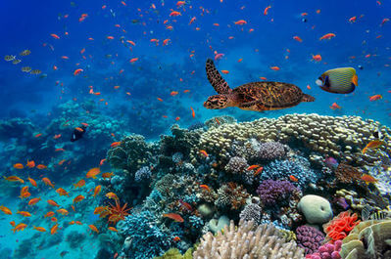
Advantageous genes were passed on, and weaker organisms without these genes could not compete for food or mates.
More died out without reproducing, eventually changing the populations enough to produce new species.
If speciation has occurred, the isolated population will no longer be able to interbreed with the original population and produce fertile offspring.
Speciation has contributed to an increased biodiversity on Earth.

